Slide 1

Chapter 7
Text files

Slide 2
Content
Processing data in text files
Definitions: file, record, fields
Part 1: reading a text file
Methods read(), readline() and readlines()
Part 2: writing to a text file
Methods write() and writelines()
Add to a file
Function exists()

Slide 3
Target
Current situation:
Data is always read via the keyboard.
Results are always shown on the screen.
After closing the program we lose the entered data and the results.
Desired situation:
Existing data is retrieved from files.
This data can be extended if necessary.
After closing the program, we save -if necessary- the entered data and the obtained results in a file.

Slide 4
Text files
One of Python's most important applications for data processing is reading, modifying and writing text files.
Data is often stored in text files because they are easily transferable between applications.
Text files or 'flat files' consist of lines of text, composed exclusively of regular characters.
Each line is closed at the end with the newline symbol \n.
Examples: txt files, csv files, py files, html files, ...
Word files and images are not flat files, but binary files.

Slide 5
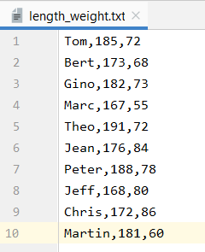
Working with files: some definitions
A file is a collection of data.
Every line in the file is a record.
Each record consists of fields: (name - length - weight)
In this file the fields are separated by a ,

Slide 6
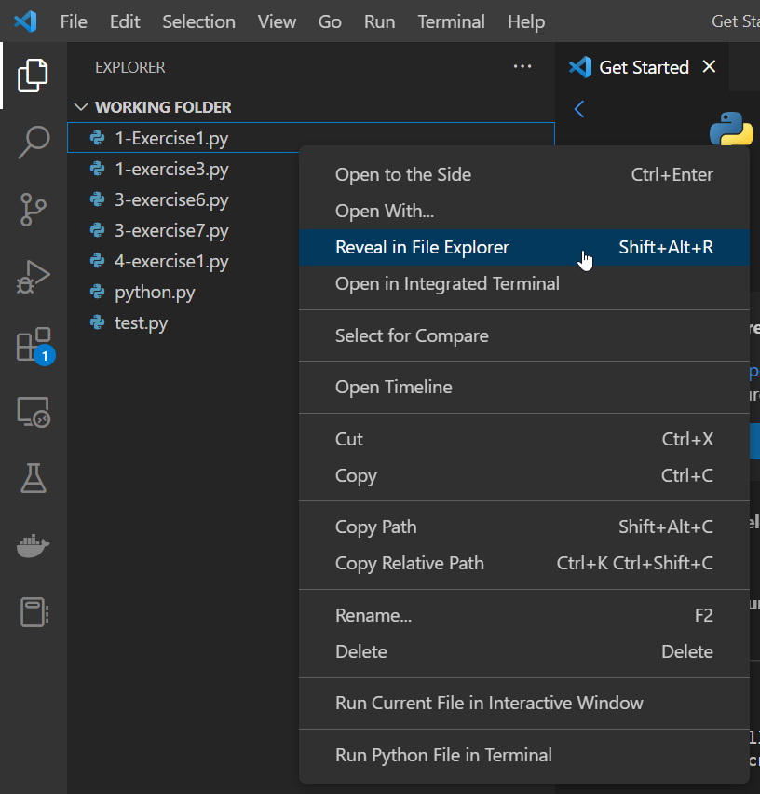
Part 1: Reading a text file
Move the file schedule.txt to your Python project folder
In Visual Studio Code you can do this by right clicking on a file in your Python project folder and next choosing ‘Reveal in File Explorer’ (Shift + Alt + R)

Slide 7
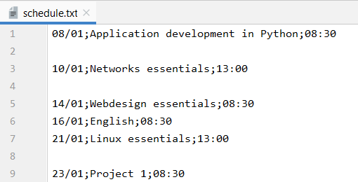
Part 1: Reading a text file
Content of the file schedule.txt
The file consists of several lines.
Each (blank) line is a record.
Each record consists of 3 fields: date - course - hour
The separator is ;

Slide 8
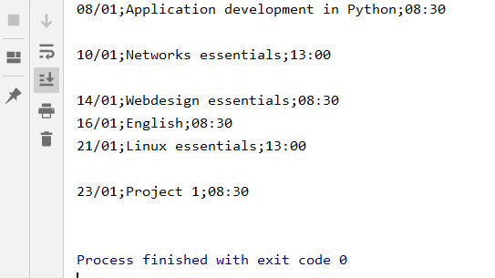
Example 1: reading a text file
#1: open file file = open('schedule.txt')
#2: read and display full content file print(file.read())
#3: close file file.close()

Slide 9
Example 1: open the file
To open a file, use the open() function.
The open() function has as argument the name of the file.
If the file is not in the current directory, you will need to specify the complete path to the file.
The open function returns a so-called "handle" or "ﬁle handle". You can see this handle as the gateway to the file. All the actions you want to perform are performed using this handle.
In the code above, the handle is called file.
#1: open file file = open('schedule.txt')

Slide 10
Example 1: read the file
The read() method of the handle produces a string containing the full content of the file.
The handle has a pointer that indicates a specific place in the file. If you open the file to read, the pointer is at the front of the file.
Reading the file moves the pointer to the character after the last read character.
After the above instruction, the pointer is at the end of the file.
When you call the read method again, it returns an empty string.
#2: read and display full content file print(file.read())

Slide 11
Example 1: close the file
Closing is done with the close()-method of the handle.
After closing, the handle is no longer attached to the file.
Files are also automatically closed at the end of the program but it is ‘best practice’ to close files explicitly via code.
#3: close file file.close()

Slide 12
Example 1: alternative method
When all the actions you want to perform with a file can be written within 1 block, you can use this code:
Note that the closing of the file is not explicitly called.
At the end of the code block, the file is automatically closed.
with open('schedule.txt') as file: # read and display full file content print(file.read())

Slide 13
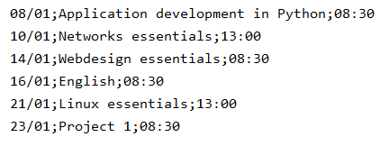
Example 2: read the file line by line
Read the file line by line so that only the meaningful records are printed. In other words, the blank lines are not retained.
The readline() method of the handle reads an entire line from the file up to the newline character.
# 1: open file with open('schedule.txt') as file:
# 2: read line by line line = file.readline() while line: if line != '\n': print(line.rstrip()) line = file.readline()
As long as there are lines... (true)
A blank line may not be printed.
Strip the character \n
Read next line

Slide 14
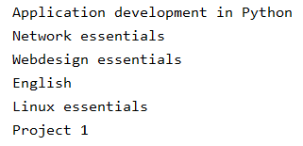
Example 3: read fields from records
Read the file line by line but just print the name of the course, not the whole line.
# 1: open file with open('schedule.txt') as file: # 2: read line by line line = file.readline() while line: if line != '\n': record = line.split(';') print(record[1]) line = file.readline()
Example: line = '08/01;Application development in Python;08:30'
line.split(';') splits the string based on separator ; in record of fields:
record[0] = '08/01'
record[1] = 'Application development in Python'
record[2] = '08:30\n'

Slide 15
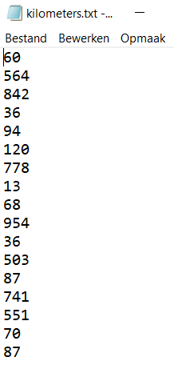
Example 4: read a file with numbers
We read the file kilometers.txt line by line and look for the difference between the largest and the smallest distance.
To read a number:
line = file.readline()
line = line.rstrip()
number = int(line)
Shorter:
line = file.readline().rstrip()
number = int(line)
Strip
Convert string to int
15

Slide 16
Example 4: read a file with numbers
with open('kilometers.txt') as file: line = file.readline().rstrip() smallest = largest = int(line) line = file.readline().rstrip() while line: number = int(line) if number > largest: largest = number else: if number < smallest: smallest = number line = file.readline().rstrip() difference = largest - smallest print('The difference between the largest and the smallest number =',
largest, '-', smallest, '=', difference)
Read first line to initialize smallest and largest
Read second line
As long as there are lines... (true)
Check if the number is larger than the largest or smaller than the smallest number so far
Read next line

Slide 17
Example 5: method readlines()
Alternative to the readline() method is the readlines() method.
This method reads all the lines of the file at once and places them in a list of strings.
Attention! These strings also contain the newline character.
with open('schedule.txt') as file: # read all lines and place them in a list of strings all_lines = file.readlines() for line in all_lines: if line != '\n': print(line, end='')
end='' ensures that print does not go to a new line after printing!

Slide 18
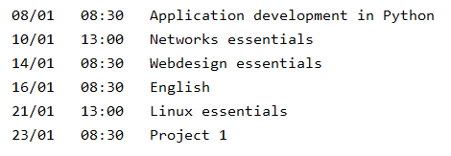
Example 6: readlines - records
From file
To output
No blank lines
Fields date and time come one after the other
Separation character is not printed

Slide 19
Example 6: readlines - records
with open('schedule.txt') as file: all_lines = file.readlines() for line in all_lines: if line != '\n': # line is split into record of fields record = line.split(';') print(record[0], record[2].rstrip(), record[1], sep='\t')
Example: line = '08/01;Application development in Python;08:30'
line.split(';') splits the string based on separator ; in record of fields:
record[0] = '08/01'
record[1] = 'Application development in Python'
record[2] = '08:30\n'
Notes:
.

Slide 20
Part 2: Writing to a text file
Procedure (same as reading):
You open the file
You write data to the file
You close the file
Attention!
When you open a file to write to, then
the file is created if it does not exist
empties the file if it already exists

Slide 21
Writing with the write() method
#1 Open file file = open('schedule.txt', 'w') #2 Write data to file file.write('25/11;Bob Potters; 08:30') file.write('30/11;René François; 12:30') file.write('02/12;Chris Benz; 10:15') #3 Close file file.close()
To open a file for writing, the 2nd argument of the open() function gets the value 'w'.
File 'schedule.txt' does not yet exist and is created. If you do not specify a path, the file will appear in the project folder.

Slide 22
Writing with the write() method
Writing is done via the write() method of the handle. As an argument you give the string you want to write.
Result of the above code is a file with 1 very long string.
So it is important to write down the newline character.
#2 Write data to file file.write('25/11;Bob Potters; 08:30') file.write('30/11;René François; 12:30') file.write('02/12;Chris Benz; 10:15')

Slide 23
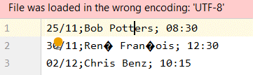
Writing with method write()
At the end of a record, the newline character is written out.
Result
#2 Write data to file file.write('25/11;Bob Potters; 08:30\n') file.write('30/11;René François; 12:30\n') file.write('02/12;Chris Benz; 10:15\n')
Attention: ‘write’ expects only 1 string parameter
The error message marked in red indicates the wrong display of het characters é and ç.
Solution is to switch to UTF-8 encoding.

Slide 24
Encoding
Encoding takes care of the interpretation of characters in a file.
Examples of this encryption are:
ASCII | 7 bit encoding or interpretation of 128 characters
UTF-8 | encoding with variable number of bytes
 | 1 byte for first 128 ASCII characters
 | 2 bytes for 1920 characters from Roman, Greek, Hebrew, Arabic alphabet
 | 3 bytes for Chinese, Japanese and Korean characters

Slide 25
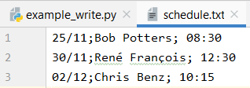
Encoding
In the open()-function you can set the encoding:
Result
#1 Open file file = open('schedule.txt', 'w', encoding='UTF-8') #2 Write data to file file.write('25/11;Bob Potters; 08:30\n') file.write('30/11;René François; 12:30\n') file.write('02/12;Chris Benz; 10:15\n') #3 Close file file.close()

Slide 26
Alternative method
When all the actions you want to perform with a file can be written within 1 block, you can use this code:
Note that the closing of the file is not explicitly called.
At the end of the code block, the file is automatically closed.
with open('schedule.txt', 'w', encoding='UTF-8') as file: # Write data to file file.write('25/11;Bob Potters; 08:30\n') file.write('30/11;René François; 12:30\n') file.write('02/12;Chris Benz; 10:15\n')

Slide 27
Writing with the method writelines()
appointments=[] appointments.append('25/11;Bob Potters; 08:30\n') appointments.append('30/11;René François; 12:30\n') appointments.append('02/12;Chris Benz; 10:15\n') with open('schedule.txt', 'w', encoding='UTF-8') as file: # Write data to file with writelines() file.writelines(appointments)
The records are first added to the list of appointments.
Using the method writelines(), all items in this list are written to the file.
Note that the newline character must be added explicitly.
The created file is identical to the one in the previous example.

Slide 28
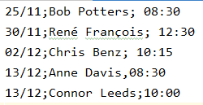
Add to a file
When you open a file in write mode (w), the file is emptied, if it already exists. What if you want to keep the existing content?
Solution is to open the file in add mode (a). The second argument of the open()-function is the letter a (of append).
The pointer is then placed at the back of the file.
with open('schedule.txt', 'a', encoding='UTF-8') as file: #2 add data from list to file with writelines() appointments=[] appointments.append('13/12;Anne Davis,08:30\n') appointments.append('13/12;Connor Leeds;10:00\n') file.writelines(appointments)

Slide 29
Function exists()
When a file already exists we often choose to open the file in append mode (a) instead of write mode (w).
So your program first has to check whether a file exists before opening it for writing.
This check is performed with the function exists().
As an argument you give the path to the file.
The function returns True when the file is found.
The function exists() is part of the library os.path and must be imported before you can use it.

Slide 30
Function exists(): example 1
from os.path import exists # check if file exists and if not create the file if exists('schedule.txt'): print('The file already exists and cannot be overwritten') else: with open('schedule.txt', 'w', encoding='UTF-8') as file: file.write('14/12;Mia Thans;12:30\n') file.write('15/12;Lian Sanchez;10:00\n')
When you run the program for the first time, schedule.txt is created
After that, the file can no longer be emptied and overwritten

Slide 31
Function exists(): example 2
from os.path import exists # check if file exists and if not create the file if exists('schedule.txt’): file = open('schedule.txt', 'a', encoding='UTF-8') else: file = open('schedule.txt', 'w', encoding='UTF-8') file.write('14/12;Mia Thans;12:30\n') file.write('15/12;Lian Sanchez;10:00\n') file.close()
When you run the program for the first time, schedule.txt is created
The file is then updated each time

